Slide 1
DATA WAREHOUSING
By
Syed Bakhtawar Shah Abid
Assistant Professor
Department of Computer Science
Data Warehousing

Slide 2
SOURCE TO TARGET MAPPING
The mapping of source system fields to the fields of a target system.
In a data warehouse, this will typically be a mapping from either source files or database tables to the respective tables in your target data warehouse / data mart.
Data Warehousing

Slide 3
SOURCE TO TARGET MAPPING
Data mapping is the lifeblood of any data integration process.
Without a proper data mapping strategy, data transformation logic and filtration errors can occur that can lead to poor quality data.
This directly impacts business analysis, forecasting, and business decision-making.
Therefore, it is crucial to maintain integrity throughout the data mapping process.
Data Warehousing

Slide 4
SOURCE TO TARGET MAPPING
Data mapping is the process of extracting data fields from one or multiple source files and matching them to their related target fields in the destination.
Data integration or ETL mapping helps consolidate data by extracting, transforming, and loading it to a data warehouse.
The initial step of ETL is data mapping.
This mapped data can then be used for producing relevant insights that can improve business efficiency.
Data Warehousing

Slide 5
SOURCE TO TARGET MAPPING
Basically, data mapping is about creating a map where source data is directed to the targeted database.
The target database can be a relational database or it can be a CSV document – it depends on the choice of the user.
In most cases, a data mapping template is used to match fields from one database system to the other using an appropriate database mapping software.
Now let’s look at a data mapping example.
Data Warehousing

Slide 6
SOURCE TO TARGET MAPPING DOCUMENT
A document that contains the mapping of source system fields to the fields of a target system.
In a data warehouse, this will typically be a mapping from either source files or database tables to the respective tables in your target data warehouse / data mart.
The STTM document is the blueprint of your ETL solution.
Data Warehousing

Slide 7
SOURCE TO TARGET MAPPING DOCUMENT
In addition to mapping the fields from source to target, the STTM document also captures the following important information:
  Loading frequency for the mapping described by the document.
  How source tables / files should be joined together in order to get the desired source dataset.
  Data types of both the source and target fields.
  Any conversion logic applied to convert between data types.
  Any business rules that need to be applied.
  Any slowly changing dimension attributes and logic.
Data Warehousing

Slide 8
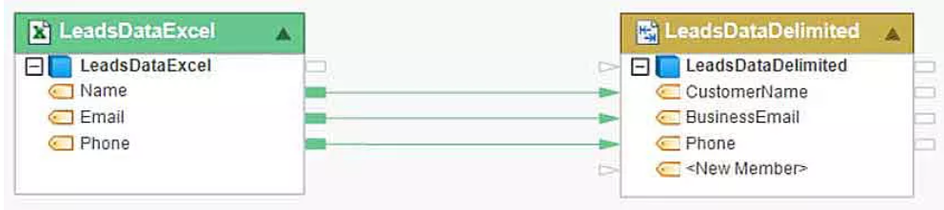
SOURCE TO TARGET MAPPING DOCUMENT
Data Warehousing

Slide 9
SOURCE TO TARGET MAPPING
Source to target mapping integration tasks vary in complexity, depending on the hierarchy of the data being mapped, as well as the disparity between the data structure of the source and the target.
Every business application, whether on-premise or cloud, uses metadata to explain the data fields and attributes that constitute the data, as well as semantic rules that govern how data is stored within that application or repository.
However, data movement controls ensure that data is transferred from source to destination without any data loss.
Data Warehousing

Slide 10
SOURCE TO TARGET MAPPING
Depending on the number, schema, and primary keys, and foreign keys of the relational databases data sources, database mapping can have a varying degree of complexity.
For instance, in the following example, data from three different database tables are joined and mapped to an Excel destination.
Data Warehousing

Slide 11
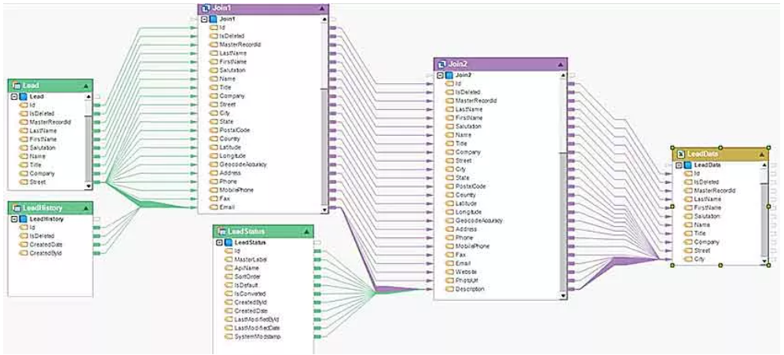
SOURCE TO TARGET MAPPING
Data Warehousing

Slide 12
SOURCE TO TARGET MAPPING
Data mapping is used to accomplish a range of data integration and transformation tasks depending on the data management needs of an enterprise and the capabilities of data conversion mapping software it uses.
Some common known use cases of mapping business data include
  Database schema mapping for pre-integration,
  Data cleansing from disparate data stores, and
  Data conversion from legacy systems.
Data Warehousing

Slide 13
SOURCE TO TARGET MAPPING
Before starting a data mapping process, data mapping teams need to make sure that they have all the information available from all stakeholders involved.
If there is any sensitive information that should be mapped separately, it should be informed to the data mapping team prior to the start of the process.
In most cases, data quality checks will be added to the data map to minimize the risk of data leak or access control sabotage.
Data Warehousing

Slide 14
Common Data Mapping Techniques
There are three main data mapping techniques:
  Manual Data Mapping:
    This requires IT professionals to hand-code or manually map data source to the target schema without the use of automating the process using a database mapping tool
  Schema Mapping:
    This is a semi-automated data mapping strategy in which a data mapping software establishes a relation between a data source and the target schema.
    Later, an IT professional checks the connections made and make any required adjustments.
  Fully-Automated Data Mapping:
    The most convenient, simple, and efficient data mapping technique is to use a code-free, drag and drop interface data mapping tool for tasks.
    A fully automated database mapping software can easily be used by non-technical business professionals.
Data Warehousing

Slide 15
IMPORTANCE OF DATA MAPPING IN THE ETL PROCESS
Data mapping in ETL helps leverage data and extract business value out of it as the information collected from various external and internal sources must be unified and transformed into a format suitable for the operational and analytical processes.
Data Warehousing

Slide 16
IMPORTANCE OF DATA MAPPING IN THE ETL PROCESS
Data mapping is accomplished through data modeling, which is an important step in various data management processes, including:
  Automated Data Mapping & Data Integration
    For successful data integration, the source and target data repositories must have the same data model, which can be achieved using a data modeling tool.
    However, it is rare for any two data repositories to have the same schema. In a data warehouse, data mapping tools help bridge the differences in the schemas of data source and destination.
    Therefore, data mapping becomes important for allowing businesses to consolidate information from different data points easily.
Data Warehousing

Slide 17
IMPORTANCE OF DATA MAPPING IN THE ETL PROCESS
Data Mapping Assists in Data Migration
  Data migration is the process of moving data from one database to another.
  Using a database mapping tool this process takes place smoothly.
  While there are various steps involved in the process, creating mappings between source and target is one of the most difficult and time-consuming tasks, particularly when done manually.
  Inaccurate and invalid mappings at this stage not only impact the accuracy and completeness of data being migrated but can even lead to the failure of the data migration project.
  Therefore, using code-free mapping software that can automate the process is important to migrate data to the destination successfully.
Data Warehousing

Slide 18
IMPORTANCE OF DATA MAPPING IN THE ETL PROCESS
Automated Data Mapping and Transformation
  Since enterprise data resides in a variety of locations and formats, data mapping and data transformation are essential to break information silos and draw insights.
  Data modeling is the first step in data transformation.
  It is done to create a framework of what changes will be made to data before it is loaded to the target database or data warehouse using the data conversion mapping feature offered by a data mapping tool.
  You will need to first bring the data to a staging area, where it will be converted to the desired format and then moved to the final destination i.e. the database or CSV file.
Data Warehousing

Slide 19
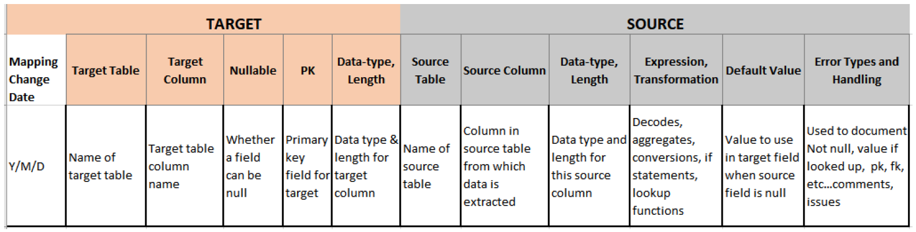
SOURCE TO TARGET MAPPING DOCUMENT
Data Warehousing

Slide 20
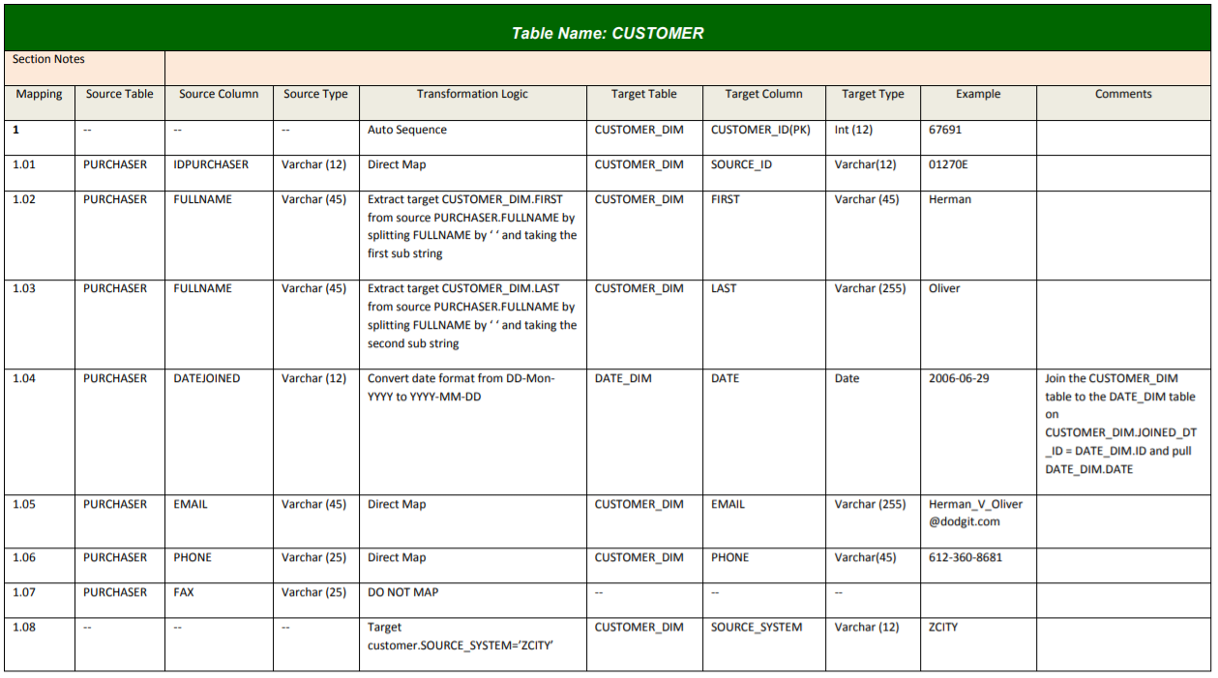
SOURCE TO TARGET MAPPING DOCUMENT
Data Warehousing

Slide 21
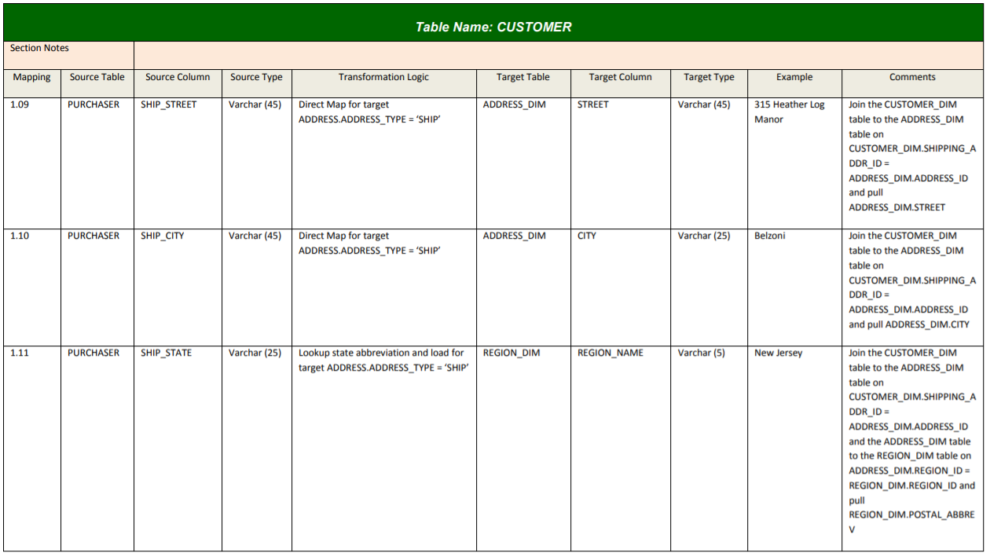
SOURCE TO TARGET MAPPING DOCUMENT
Data Warehousing

Slide 22
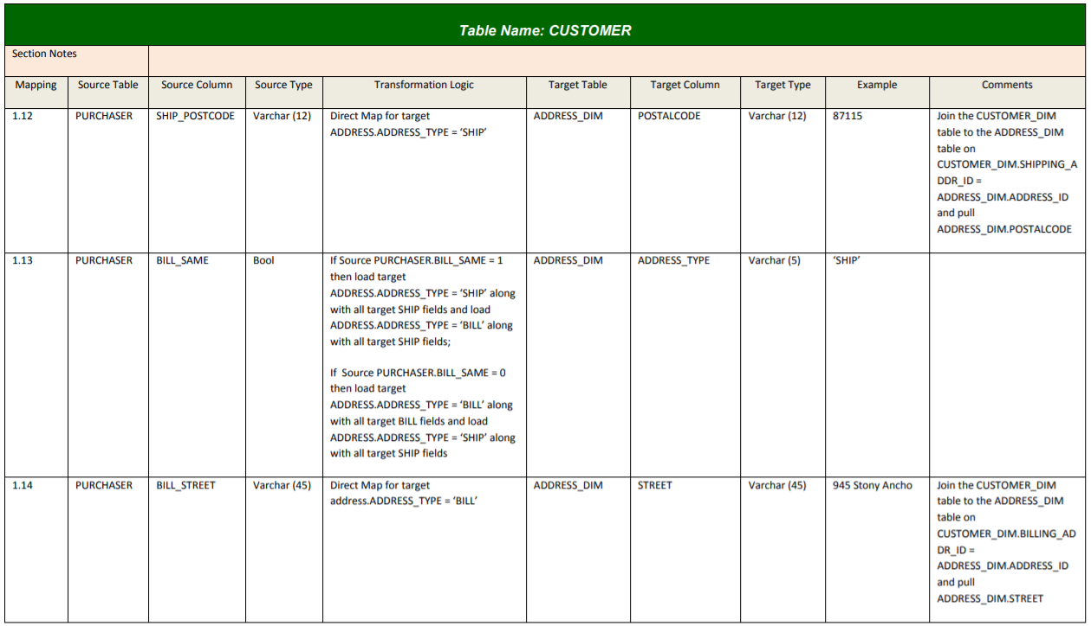
SOURCE TO TARGET MAPPING DOCUMENT
Data Warehousing

Slide 23
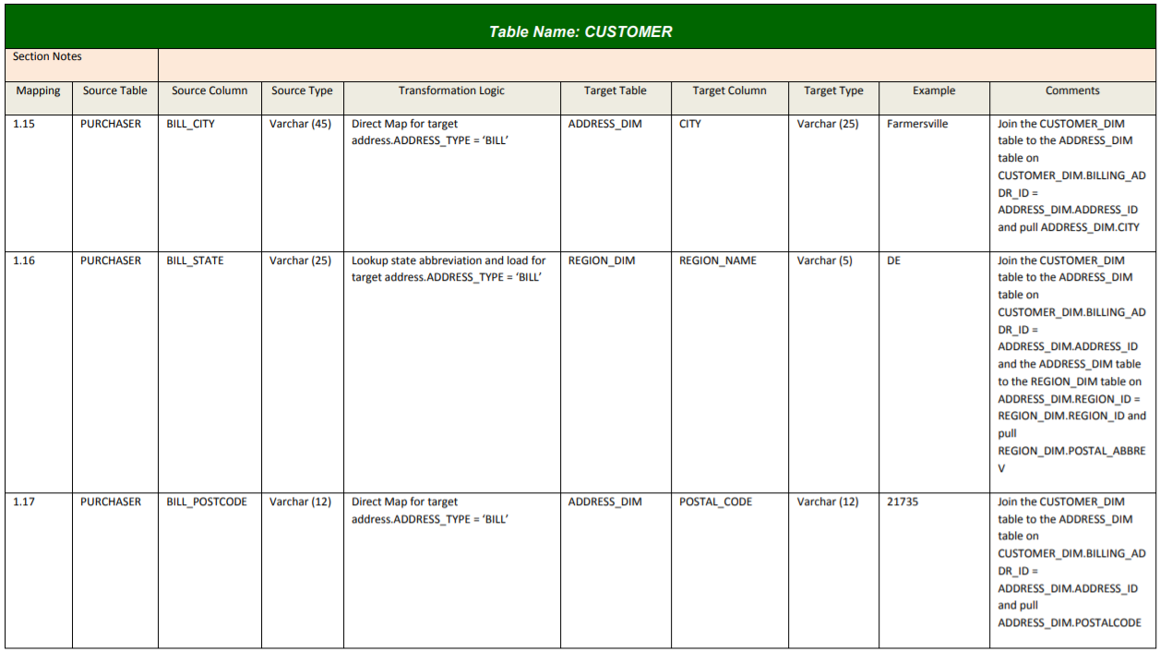
SOURCE TO TARGET MAPPING DOCUMENT
Data Warehousing

Slide 24
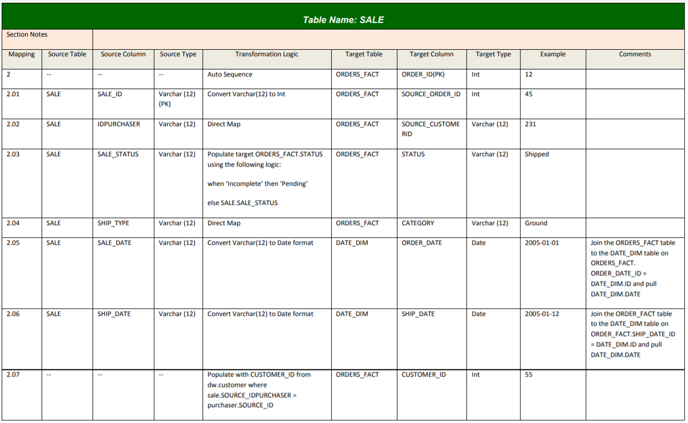
SOURCE TO TARGET MAPPING DOCUMENT
Data Warehousing

Slide 25
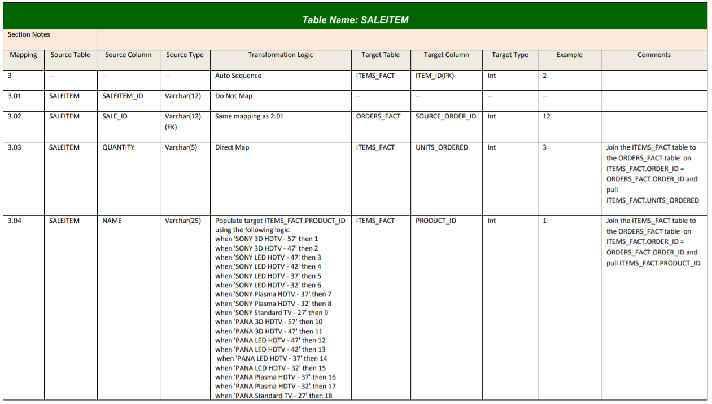
SOURCE TO TARGET MAPPING DOCUMENT
Data Warehousing

Slide 26
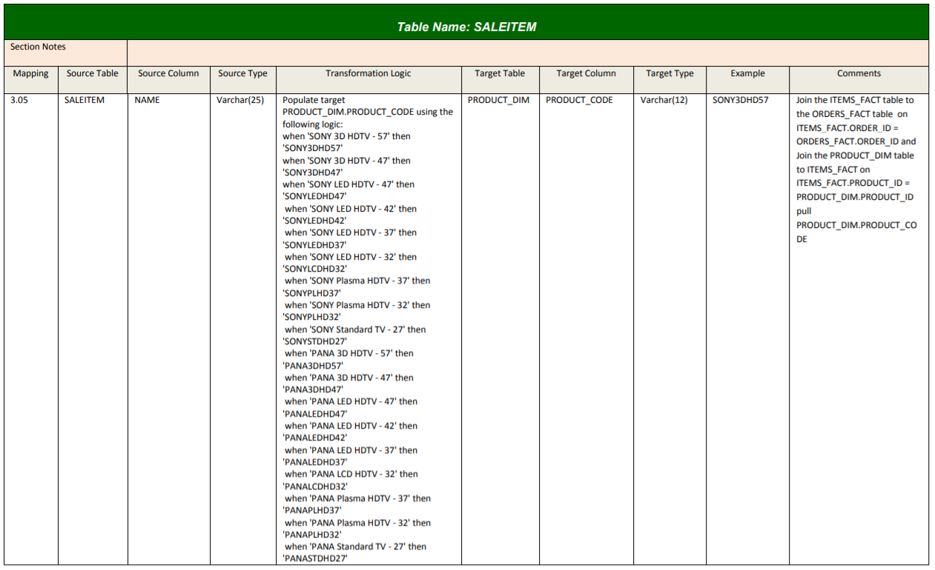
SOURCE TO TARGET MAPPING DOCUMENT
Data Warehousing

Slide 27
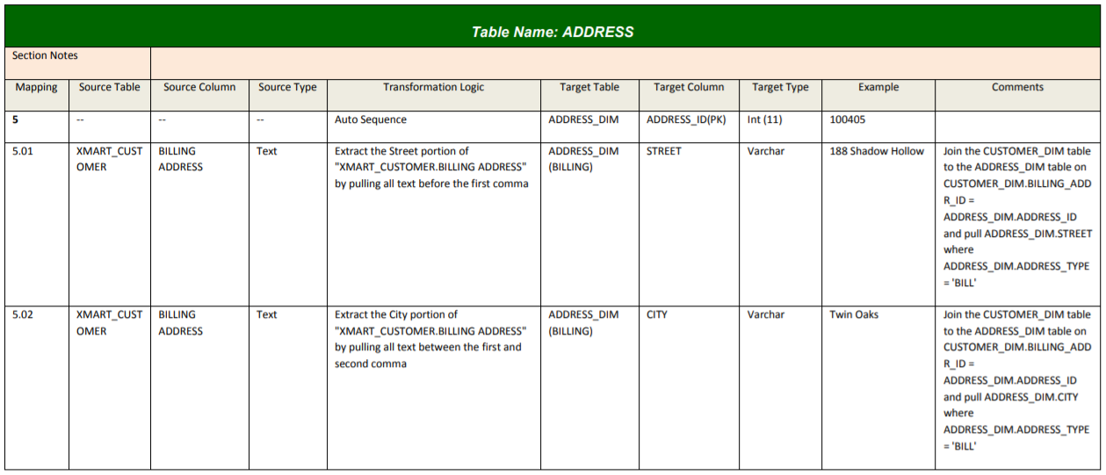
SOURCE TO TARGET MAPPING DOCUMENT
Data Warehousing

Slide 28
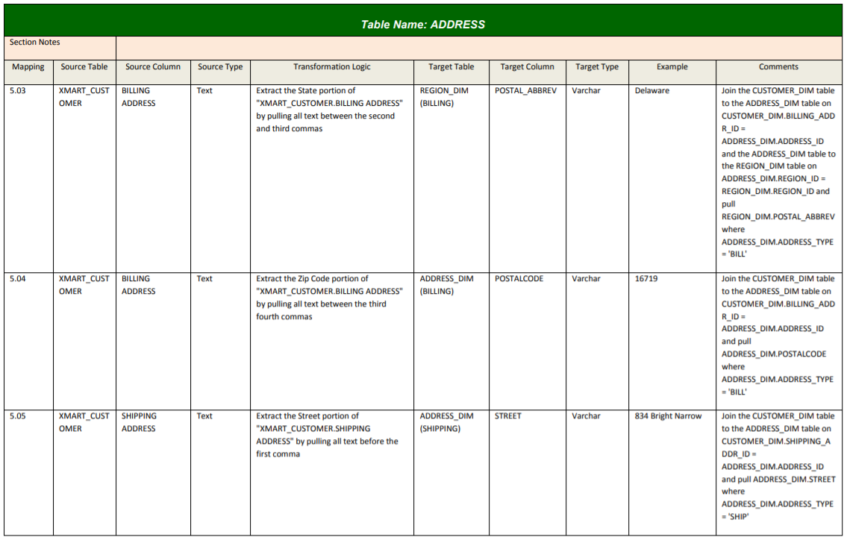
SOURCE TO TARGET MAPPING DOCUMENT
Data Warehousing

Slide 29
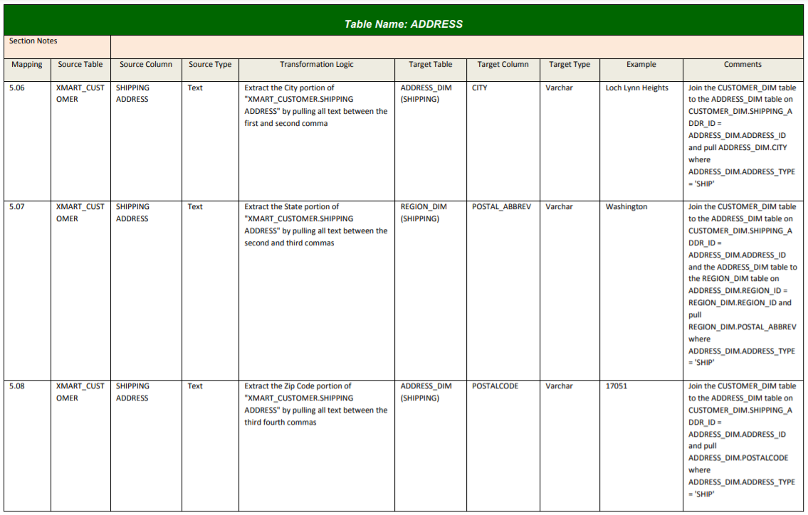
SOURCE TO TARGET MAPPING DOCUMENT
Data Warehousing

